Slide 1
Introduction to MCMC with applications in Generative Adversarial Networks
By Zac Schulwolf
Mentored by Joseph Jackson

Slide 2
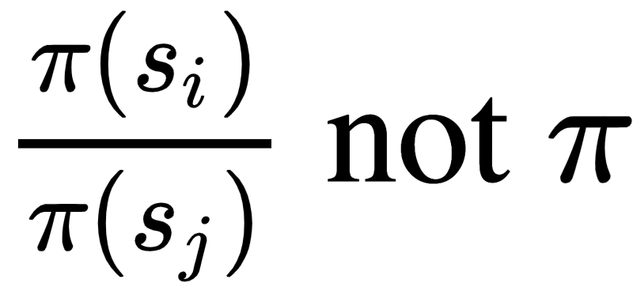
What is MCMC?
MCMC stands for Markov Chain Monte Carlo
Class of algorithms that are used to sample from a probability distribution
Creates a Markov Chain with the given distribution as its stationary distribution
With Metropolis-Hasting we just need
Notes:
A example of sampling is generating a random number between 0 and 1 from a uniform distribution

Slide 3
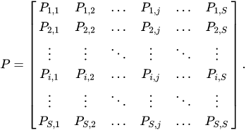
Markov Chains
A Markov chain is a stochastic model describing a sequence of possible events
The probability of each event depends only on the state attained in the previous event
Each markov chain has a state space and a transition function

Slide 4
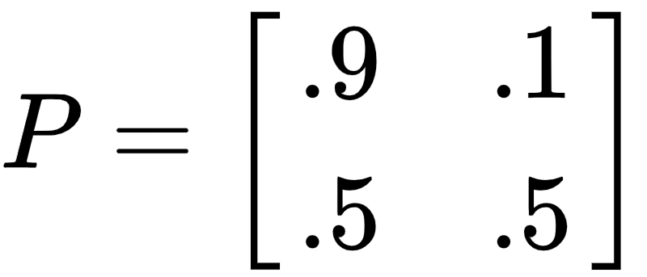
Markov Chain Example
Weather example
Let's say today is sunny:
Predict tomorrow's weather:
What can we predict the weather to be in 10 days? 100 days? Infinite days?

Slide 5
Stationary Distribution of a Markov Chain
Limiting Distribution:
Stationary Distribution:
If P is irreducible and aperiodic there is a unique stationary distribution 𝝅 which is also the limiting distribution
Notes:
Some Markov Chains have the property that as the number of transitions approaches infinity, the output distribution approaches a limiting distribution
irreducible: every state can be reached from every other state

Slide 6
Metropolis-Hasting Algorithm
We want to build a new transition matrix (P) with stationary distribution (𝝅)
Start with any symmetric transition matrix (𝚿) on your desired state space (𝛀)
For each transition let's accept the output state of 𝚿 with a probability of a(x,y) and reject with a probability 1-a(x,y)
Notes:
psi

Slide 7
Metropolis-Hasting Algorithm
The detailed balance equation states that the transition matrix P has a stationary distribution 𝝅 if the following equation is satisfied
Set
Now P is a transition matrix whose stationary is 𝝅
Notes:
𝚿(x,y)=𝚿(y,x) because 𝚿 is symmetric
a(x,y)<=1 so 𝝅(x)a(x,y) < 𝝅(x)
The Metropolis chain for a probability 𝝅 and a symmetric transition matrix 𝚿 is P

Slide 8
When to use MCMC
Any problem where we want to sample from an arbitrary distribution that isn’t “samplable”
Graph Coloring: given a correct coloring of a graph can we uniformly generate other valid colorings of the graph?
Glauber Dynamics for proper q-colorings
State Space: S^{V}, S is a finite set of q-colors, V number of vertices in graph
Generate new colorings by
Selecting a vertex v ∈ V at random,
Selecting a color j uniformly at random from the allowable colors at v,
Re-coloring vertex v with color j
This satisfies the detailed balance equation:
Stochastic Gradient Descent
Notes:
(|V|*|Av(x)|)^-1

Slide 9
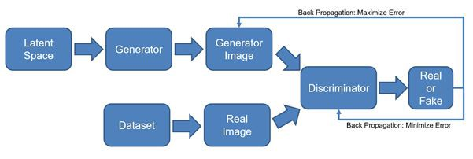
Generative Adversarial Networks
Deep learning based generative model
Two models are trained together in a zero-sum game competing against each other
Notes:
~10 min

Slide 10
DC-GAN
Simple GAN model
Notes:
Deep Convolutional Generative Adversarial Network (DCGAN).
Generator: UpConv, Batch Norm, Relu, … Tanh
Discriminator: Conv, Batch Norm, LeakyRelu, … Sigmoid

Slide 11
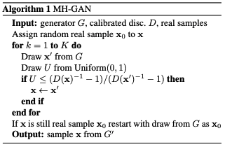
Metropolis-Hastings GANs
Slight modification to any GAN that improves the quality of the generated images
Training is the same, only change is how we use the Generator to generate new samples
Runs a Metropolis-Hastings like algorithm on K-number of generated images
arXiv:1811.11357v2

Slide 12
Connection between MH and GANs
Proposal Distribution = p_{G} which is sampled by the generator
Acceptance Probability = [D⁻¹(x)-1]/[D⁻¹(y)-1], calculated by the Discriminator
Stationary Distribution = p_{Di} distribution implied by the Discriminator independent of the Generator
Optimal D for G: p_{Di}= p_{data}≠ p_{G}

Slide 13
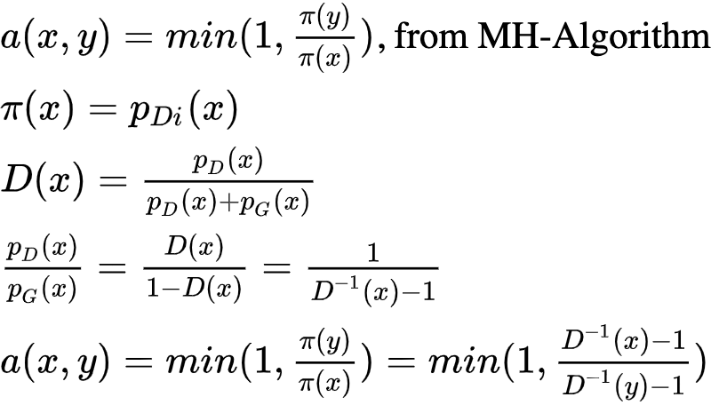
Acceptance Formula
Notes:
a(x,y) = min(1,\frac{\pi(y)}{\pi(x)})\text{, from MH-Algorithm}\\
\pi(x) = p_{D}(x)\\
D(x) = \frac{p_D(x)}{p_D(x)+p_G(x)}\\
\frac{p_D(x)}{p_G(x)}=\frac{D(x)}{1-D(x)}=\frac{1}{D^{-1}(x)-1}\\
a(x,y) = min(1,\frac{\pi(y)}{\pi(x)}) = min(1,\frac{D^{-1}(x)-1}{D^{-1}(y)-1})

Slide 14
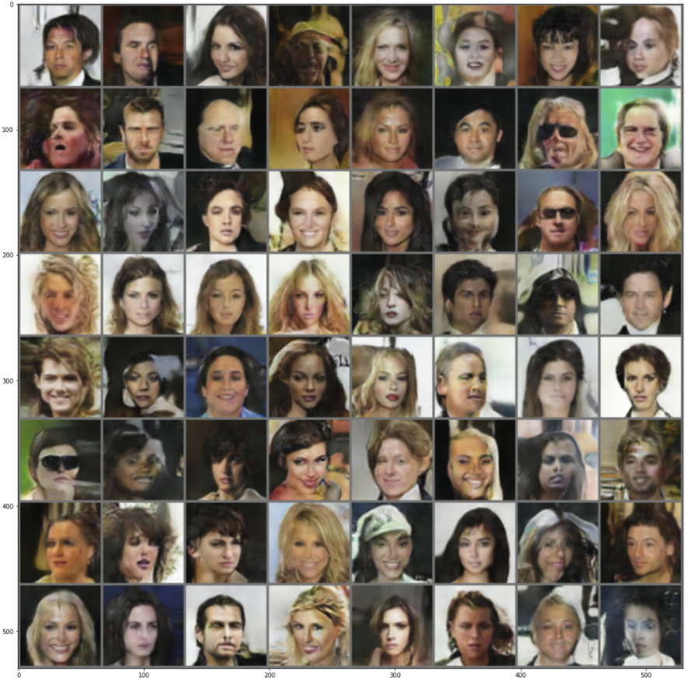
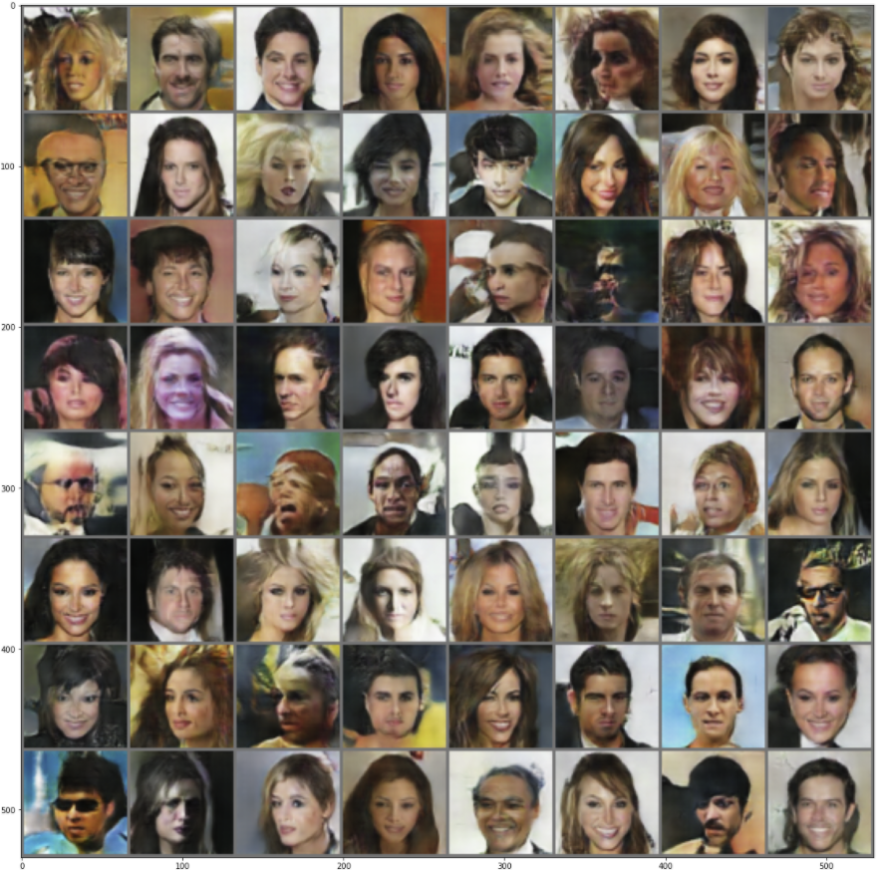
Testing on Celeba dataset
MH-GAN
DC-GAN
Notes:
20 Epochs

Slide 15
References
arXiv:1811.11357v2
Levin, David A., et al. Markov Chains and Mixing Times. American Mathematical Society, 2017.
pytorch.org/tutorials/beginner/dcgan_faces_tutorial.html
en.wikipedia.org/wiki/Examples_of_Markov_chains
medium.com/@Packt_Pub/inside-the-generative-adversarial-networks-gan-architecture-2435afbd6b3b
gluon.mxnet.io/chapter14_generative-adversarial-networks/dcgan.html

